Slide 1
Concurrent Data Structures
The University of Illinois at Chicago
Vishwas, Amogh & Anirudh
{vsreev2, avenka35, akrish43}@uic.edu

Slide 2
Introduction
Data structure – A way to store chunks of data
Differ in ways data is stored and accessed
Identified with efficiency paramaters

Slide 3
Concurrent Data Structures
Shared Memory - Many threads or processes utilize a shared data resource
Need for protocol to manage resource sharing

Slide 4
Need for Concurrency
Proliferation of commercial shared-memory multiprocessor machines has brought about significant changes in the art of concurrent programming.

Slide 5
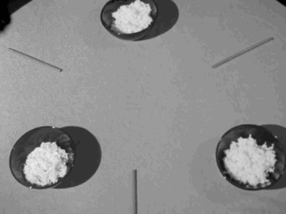
The dining Philosophers

Slide 6


Slide 7


Slide 8
Philosopher is either “THINKING” or “EATING” state.
They have to share a crucial resource, which is the utensil
Consider the condition, all philosophers decide to pick up their right fork

Slide 9
Concurrent Structure - counter
Simple single valued Structure that performs increments and decrements.
typedef struct counter
{
int value;
}

Slide 10
Functionality
void increment(counter-t *c)
{
c->value++;
}
void decrement(counter-t *c)
{
c->value--;
}

Slide 11
Using mutex
Defining the lock
typedef struct counter_t
{
int value;
pthread_mutex_t lock;
}

Slide 12
Counter Using Mutex
void increment(counter_t *c)
{
Pthread_mutex_lock(&c->lock);
c->value++;
Pthread_mutex_unlock(&c->lock);
}

Slide 13
void decrement(counter_t *c)
{
Pthread_mutex_lock(&c->lock);
c->value--;
Pthread_mutex_unlock(&c->lock);
}

Slide 14
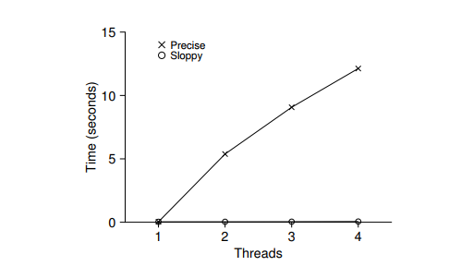
Performance Analysis
Simulation Environment – n processes accessing the lock 1 million times per second
Reduced Efficiency

Slide 15
Scalable Counting
Reduce frequency with which shared resource is accessed, by using local operations
typedef struct __counter_t
{
int global;
pthread_mutex_t glock;
int local[NUMCPUS];
} counter_t;

Slide 16
void update(counter_t *c, int threadID, int amt)
{
int cpu = CPU_NUM;
c->local[cpu] += amt;
if (c->local[cpu] >= c->threshold)
{
pthread_mutex_lock(&c->glock);
c->global += c->local[cpu];
pthread_mutex_unlock(&c->glock);
c->local[cpu] = 0;
}
}

Slide 17
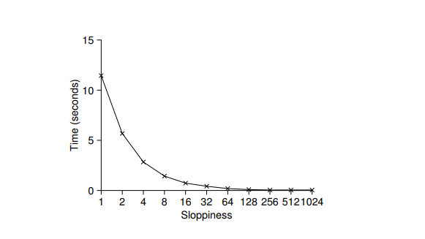
Improved Performance with sloppy clocks
Sloppiness is the threshold value till which operation is done locally without accessing global resource

Slide 18
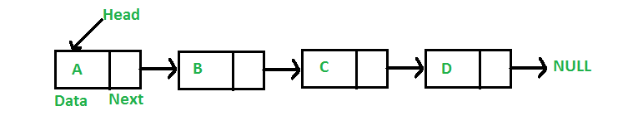
Linked Lists
Linked List is a linear data structure
Elements are not stored at contiguous location
Dynamic Sizing
Ease of Insertion & Deletion

Slide 19
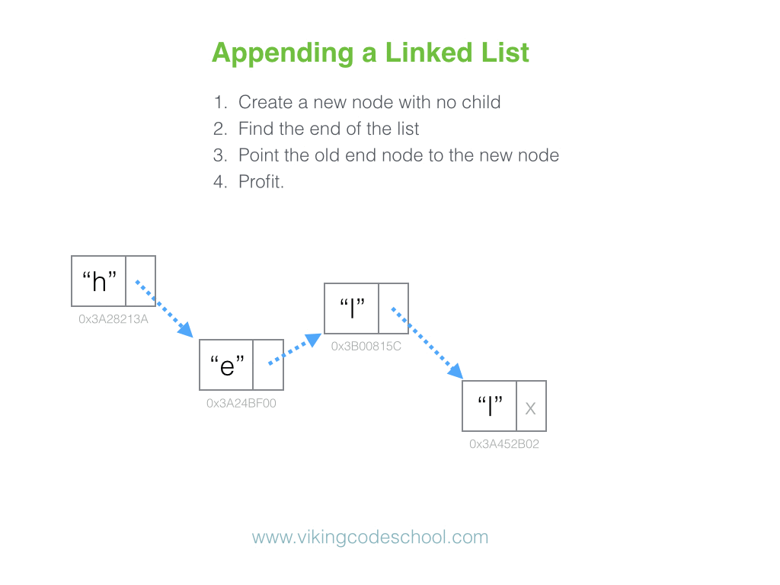
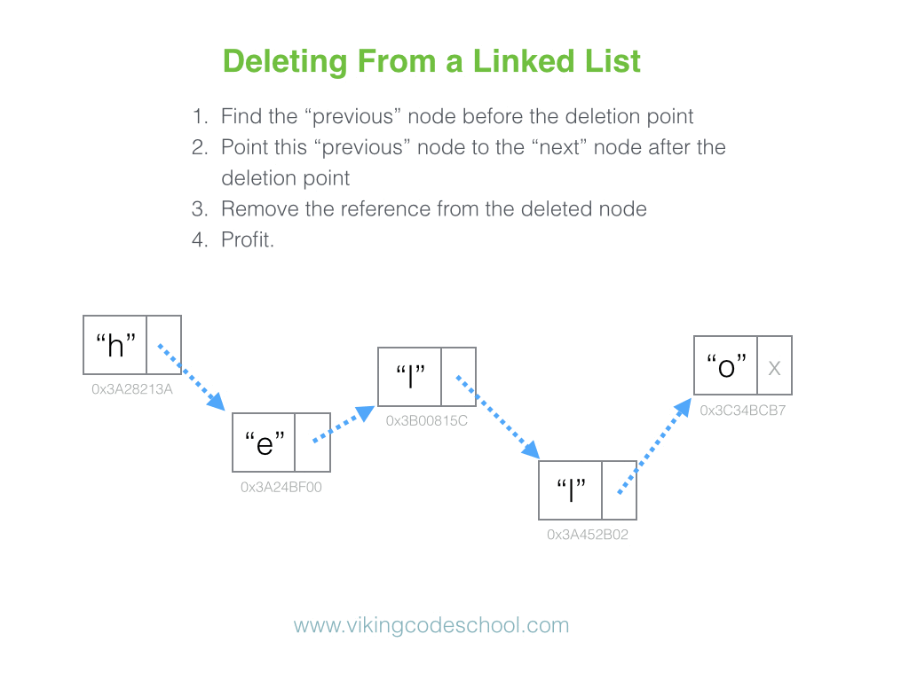
Linked Lists
Basic operations

Slide 20
Lock-Based Concurrent Linked Lists
typedef struct __node_t {
int key; // basic node structure
struct __node_t *next;
} node_t;
typedef struct __list_t {
node_t *head; // basic list structure (one used per list)
pthread_mutex_t lock;
} list_t;
void List_Init(list_t *L) {
L->head = NULL; //Initialize
pthread_mutex_init(&L->lock, NULL);
}

Slide 21
Single global lock
Acquire a lock in the insert routine upon entry
Release it upon exit
Issue arises if malloc() happens to fail

Slide 22
Single global lock
Insertion
int List_Insert(list_t *L, int key) {
pthread_mutex_lock(&L->lock);
node_t *new = malloc(sizeof(node_t));
if (new == NULL) {
perror("malloc");
pthread_mutex_unlock(&L->lock);
return -1; // fail
}
new->key = key;
new->next = L->head;
L->head = new;
pthread_mutex_unlock(&L->lock);
return 0; // success
}

Slide 23
Single global lock
Lookup
int List_Lookup(list_t *L, int key) {
pthread_mutex_lock(&L->lock);
node_t *curr = L->head;
while (curr) {
if (curr->key == key) {
pthread_mutex_unlock(&L->lock);
return 0; // success
}
curr = curr->next;
}
pthread_mutex_unlock(&L->lock);
return -1; // failure
}

Slide 24
Single global lock
Improvising
Can we rewrite the insert and lookup routines to remain correct under concurrent insert but avoid the case where the failure path also requires us to add the call to unlock?
YES.

Slide 25
Single global lock
Insertion
void List_Insert(list_t *L, int key) {
// synchronization not needed
node_t *new = malloc(sizeof(node_t));
if (new == NULL) {
perror("malloc");
return;
}
new->key = key;
// just lock critical section
pthread_mutex_lock(&L->lock);
new->next = L->head;
L->head = new;
pthread_mutex_unlock(&L->lock);
}

Slide 26
Single global lock
Lookup
int List_Lookup(list_t *L, int key) {
int rv = -1;
pthread_mutex_lock(&L->lock);
node_t *curr = L->head;
while (curr) {
if (curr->key == key) {
rv = 0;
break;
}
curr = curr->next;
}
pthread_mutex_unlock(&L->lock);
return rv; // now both success and failure
}

Slide 27
Per-node locks
Scaling
Instead of having a single lock for the entire list, add a lock per node of the list
So list traversal must be pretty simple, right? Simply lock a node, read its next pointer, release the current node’s lock, and move on.

Slide 28
Per-node locks
A Race condition
T1:
node0->mutex_->lock();
node1 = node0.next_;
node0->mutex_->unlock();
T2: // remove node1 from list
T1: node1->mutex_->lock(); // oops
We need a way to ensure that the action of reading a next pointer and locking the next node is atomic. Otherwise, we could end up reading removed nodes.

Slide 29
Per-node locks
Solution…
Hand-over-hand locking (a.k.a. lock coupling) to the rescue: Lock the next node before releasing the lock on the current node
When traversing the list, the code first grabs the next node’s lock and then releases the current node’s lock

Slide 30

Per-node locks
Hand-over-Hand locking

Slide 31
Per-node locks
Performance
It enables a high degree of concurrency in list operations
More concurrency isn’t necessarily faster
Even with very large lists, and a large number of threads, the concurrency enabled by allowing multiple ongoing traversals is unlikely to be faster

Slide 32
Non blocking Linked Lists
No locks involved
Simple constructs are enough for implementing lock free linked lists
The simplest and most popular universal primitive, is the compare-and-swap (CAS) operation

Slide 33
The powerful CAS
It turns out that compare-and-swap, while seemingly trivial, is actually a really powerful primitive.
Can be used to solve the infinite consensus problem
In other words, any concurrent data structure which is implementable on a Turing machine can be implemented in a wait free manner using CAS.

Slide 34
The powerful CAS
template <typename T>
bool compare_and_swap(T *dst, T exp, T desired)
{ // do atomically
if (*dst == exp) {
*dst = desired;
return true;
}
return false;
}

Slide 35
Hardware support
Modern processors usually support a variety of atomic primitives
To permit this, x86 has dedicated instructions for CAS on 8 and 16 bytes of data, cmpxchg8b and cmpxchg16b

Slide 36
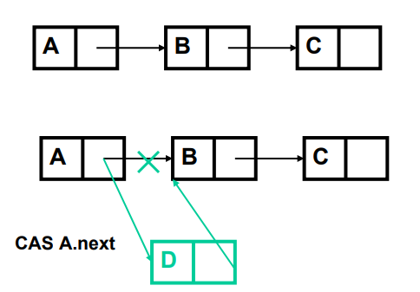
Non blocking Linked Lists
Insertion
Search for the right spot in the list
Append using CAS pointer trick
No overhead of taking locks
No per-node storage overhead

Slide 37
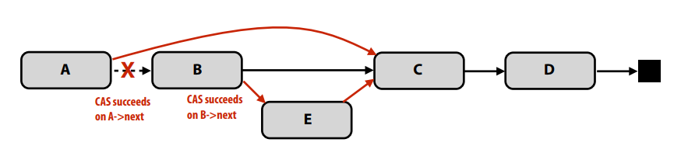
Non blocking Linked Lists
Deletion
Supporting lock-free deletion significantly complicates data-structure
Consider case where B is deleted simultaneously with successful insertion of E after B. B now points to E, but B is not in the list!

Slide 38
Non blocking Linked Lists
A solution by Harris
Replace the right pointer of each node with a composite field - a successor field
Successor field consists of a right pointer and a mark bit
When a process needs to change the right pointer of a node, it applies CAS to the successor field of that node
A mark bit acts as a toggle
Normally, the mark bit is 0

Slide 39
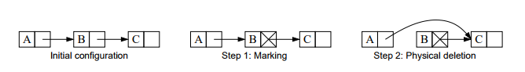
Non blocking Linked Lists
A solution by Harris
Uses two CAS’s. The first marks B’s successor field by setting its mark bit to 1
The second removes B from the list
A node is logically deleted after the first step, and physically deleted after the second step

Slide 40
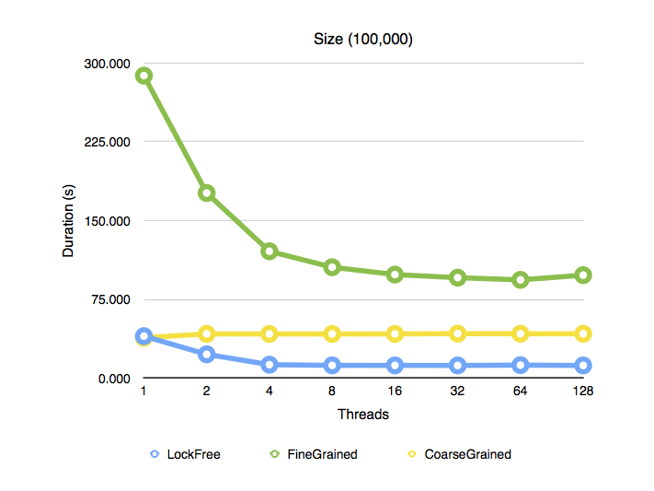
Performance results
Lock-free linked lists outperformed its rivals in almost every single iteration of every single test, often by a wide margin.

Slide 41
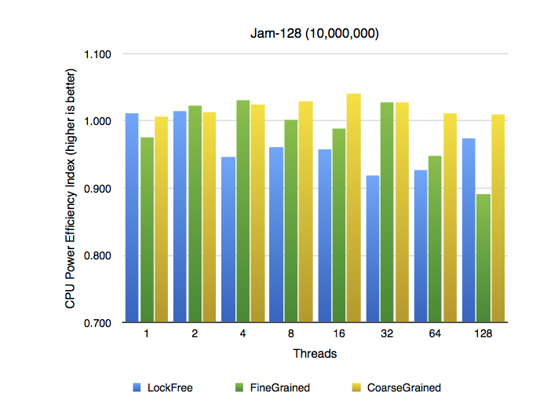
Performance results
Not only does Lock Free execute way, way faster, it consumes even less electricity, apparently.

Slide 42
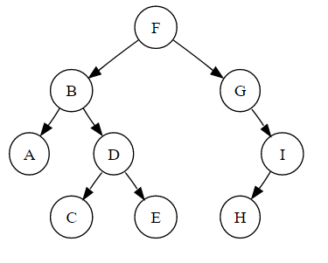
Binary search trees
Hierarchical data structure with a single reference to root node
All descendants of the left child of x have keys that are strictly less than the key of x
All descendants of the right child of x have keys that are greater than or equal to the key of

Slide 43
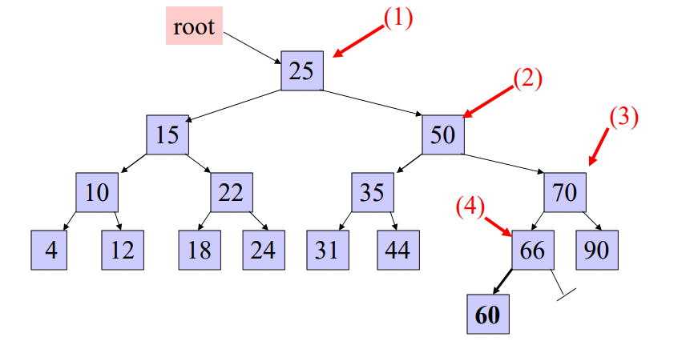
Binary search trees
Insertion
Always insert new node as leaf node
Start at root node as current node
If new node’s key < current’s key: If current node has a left child, search left , Else add new node as current’s left child
If new node’s key > current’s key : If current node has a right child, search right 2, Else add new node as current’s right child

Slide 44
Binary search trees
Deletion
Deleting a node with no children: simply remove the node from the tree
Deleting a node with one child: remove the node and replace it with its child.
Deleting a node with two children: Find inorder predecessor /successor of the node. Copy contents of the inorder predecessor or successor to the node and delete the inorder successor.

Slide 45
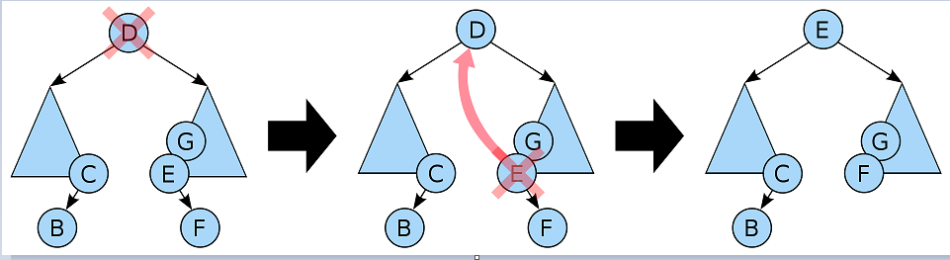
Binary search trees
Deletion
Deleting a node with two children: call the node to be deleted D. Do not delete D. Instead, choose either its in-order predecessor or successor node as replacement node E. Copy the user values of E to D. If E does not have a child simply remove E from its previous parent G. If E has a child, say F, it is a right child. Replace E with F at E's parent.

Slide 46
Binary search trees
Searching
def search-recursively(key, node):
if node is None or node.key == key:
return node
if key < node.key:
return search_recursively(key, node.left)
# key > node.key
return search_recursively(key, node.right

Slide 47
Concurrent binary search trees
Concurrent implementation of any search tree can be achieved by using a single exclusive lock
Concurrency can be improved by holding the lock in shared mode for search operations and update operations by acquiring an exclusive lock.
Fine-grained locking improves concurrency further

Slide 48
Concurrent binary search trees
Kung and Lehman presented a solution: update operations hold only a constant number of node locks and seach ops are never blocked
Does not balance the tree
Lehman-Yao algorithm - update operations as well as search operations use the lock coupling technique
Do not address how nodes can be merged
The more sophisticated techniques become more complicated, resulting in deadlocks

Slide 49
Non blocking BSTs
Given by Eric Ruppert, non blocking bst uses single word CAS
Properties:
Conceptually simple
Fast searches
Concurrent updates to different parts of tree do not conflict
Experiments show good performance
Asynchronous
Shared memory with single-word compare-and-swap
Linearizable
Uses leaf oriented BST

Slide 50
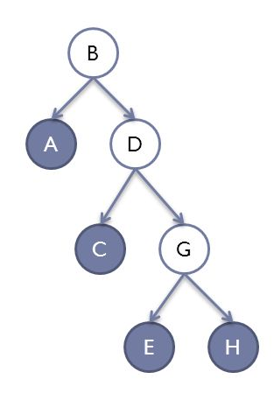
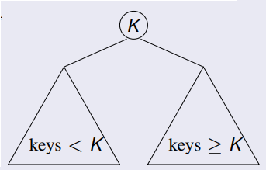
Leaf oriented BST
Example : {A, C, E, H}
One leaf for each key in set
Internal nodes used only for routing
Each internal node has exactly 2 children
BST property:

Slide 51
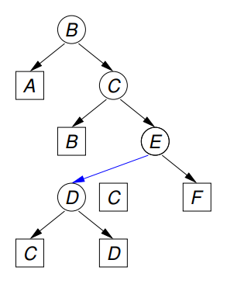
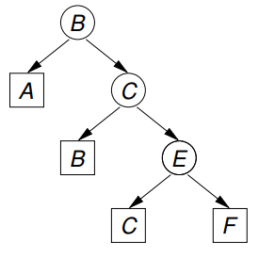
Leaf oriented BST : Insertion
Insert D

Slide 52
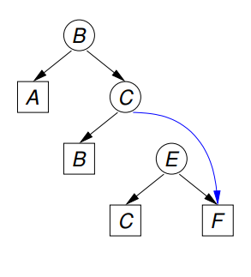
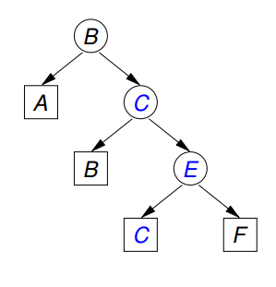
Leaf oriented BST : Deletion
Delete C

Slide 53
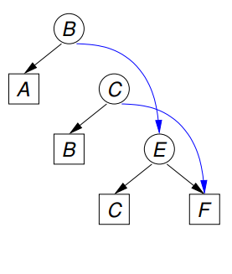
Challenges of concurrency
Concurrent Delete(B) and Delete(C)
C is still reachable from the root!

Slide 54
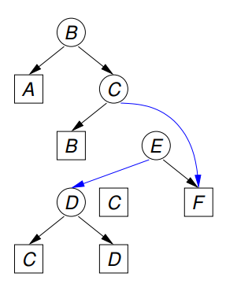
Challenges of concurrency
Concurrent Delete(C) and Insert(D).
D is not reachable from the root!

Slide 55
Challenges of concurrency
Concurrent Delete(C) and Insert(D).
D is not reachable from the root!

Slide 56
Achieving coordination: Flags & Marks
An internal node can be either flagged or marked (but not both)
Status is changed using CAS
Flag indicates that an update is changing a child pointer
Mark indicates an internal node has been (or soon will be) removed from the tree

Slide 57
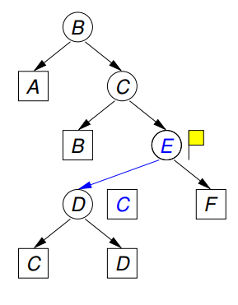
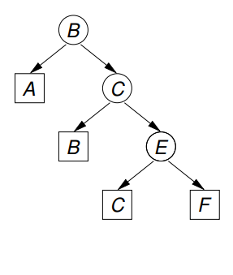
Non blocking Insertion
Search for D
Remember leaf and its parent
Create three new nodes
Flag parent (if this fails, retry from scratch)
Swing pointer (using CAS)
Unflag parent
Insert(D)

Slide 58
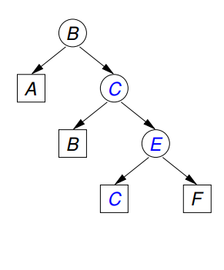
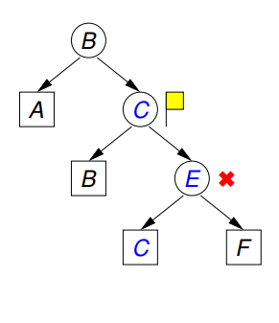
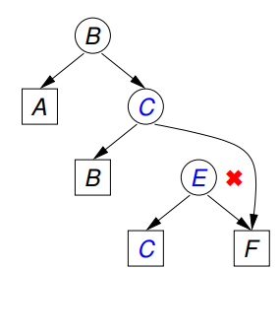
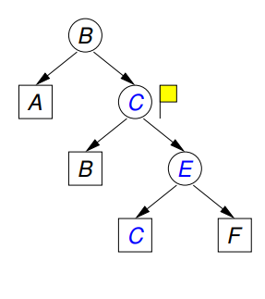
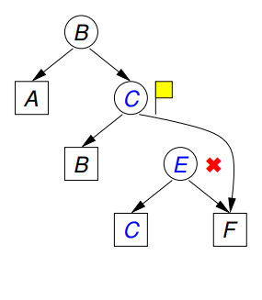
Non blocking deletion
Search for C
Remember leaf, its parent and grandparent
Flag grandparent (if this fails, retry from scratch)
Mark parent (if this fails, unflag grandparent and retry from scratch)
Swing pointer (using CAS)
Unflag grandparent

Slide 59
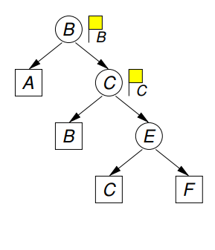
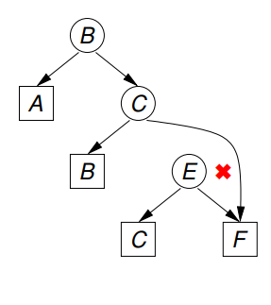
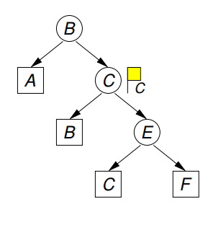
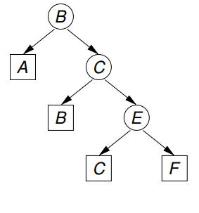
Concurrent deletions
Concurrent Delete(B) and Delete(C)
Case I: Delete(C)’s flag succeeds.
Even if Delete(B)’s flag succeeds, its mark will fail.
Delete(C) will complete
Delete(B) will retry

Slide 60
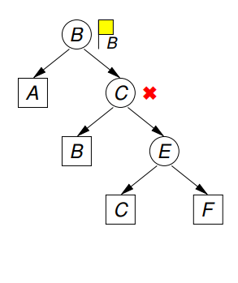
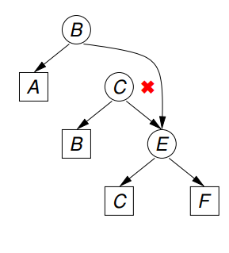
Concurrent deletions
Concurrent Delete(B) and Delete(C)
Case II: Delete(B)’s flag and mark succeed
Delete(C)’s flag fails
Delete (B) will complete
Delete(C) will retry

Slide 61
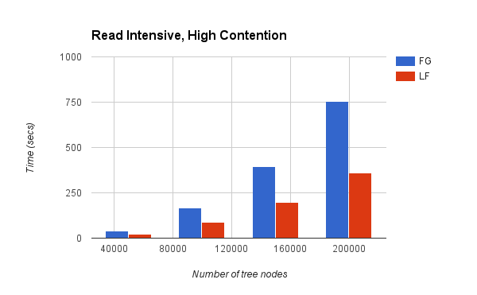
Performance

Slide 62

Stack
Last In First Out collection
Linear data structure

Slide 63
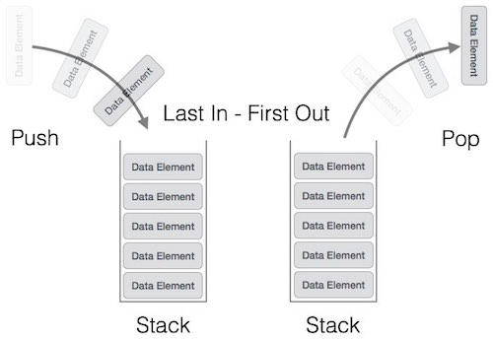
Operations of Stack
push()
pop()
Additional operations
peek()
isFull()
isEmpty()

Slide 64
Push()
begin procedure push: stack, data
if stack is full
return null
endif
top ← top + 1
stack[top] ← data
end procedure

Slide 65
Pop()
begin procedure pop: stack
if stack is empty
return null
endif
data ← stack[top]
top ← top – 1
return data
end procedure

Slide 66
Lock Based Stack
Acquires lock on entry to push or pop function.
Releases the lock on exit from the function.

Slide 67
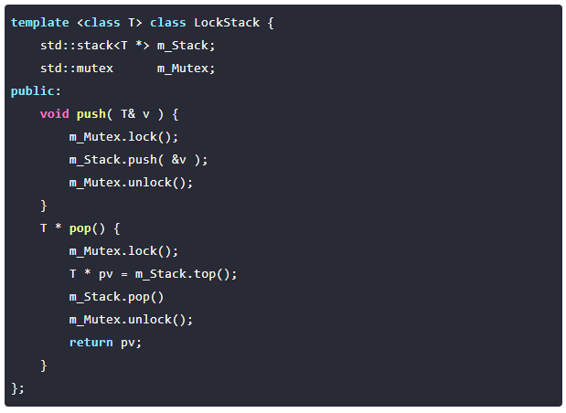
Lock Based Stack

Slide 68
Lock free Stack
No locks involved.
Uses Compare and Swap to perform Push and Pop operations.
Uses Back Off mechanism to overcome contention.

Slide 69
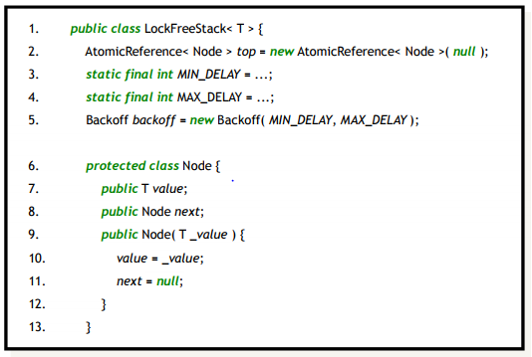
Lock free Stack

Slide 70


Slide 71
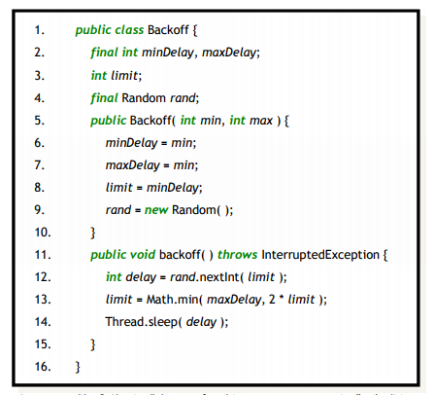
Backoff

Slide 72
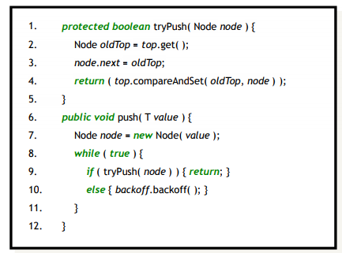
Lock-Free Stack: Push

Slide 73
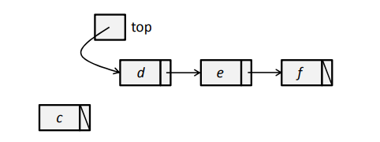
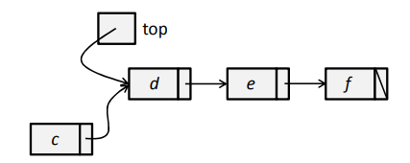
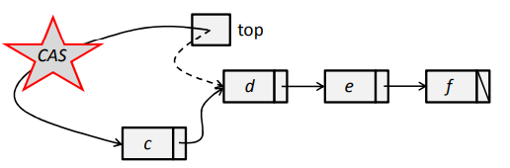

Slide 74
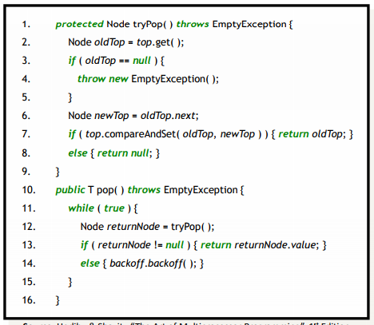
Lock-Free Stack: Pop

Slide 75
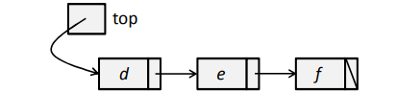
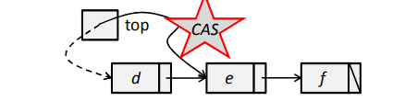

Slide 76
Lock-free Stack: ABA problem
Thread 1 looks at some shared variable, finds that it is ‘A’
Thread 1 calculates some interesting thing based on the fact that the variable is ‘A’
Thread 2 executes, changes variable to B
If Thread 1 wakes up now and tries to compare-and-set, all is well – compare and set fails and Thread 1 retries.
Instead, Thread 2 changes variable back to A!

Slide 77
Thread 1:
pop()
read A from head
store A.next `somewhere’
Thread 2:
pop()
pops A, discards it
First element becomes B memory manager recycles ‘A’ into new variable
Pop(): pops B
Push(head, A)
Thread 1:
cas with A suceeds

Slide 78
Solution to ABA problem
Keep a ‘update count’ (needs ‘doubleword CAS’)
Don’t recycle the memory ‘too soon’

Slide 79
HashMap
It consists of Key-Value pairs.
Key is used to look up Values.
Hash Function

Slide 80
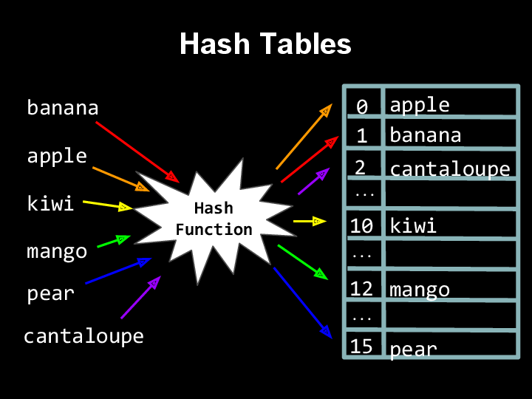

Slide 81
Operations on a Hash Map
Insert
Search
Delete

Slide 82
Hashing and hash function
In order to insert a new record, the key must somehow be converted to an array index.
The index is called the hash value of the key.
The hash value is used for the location of the new record.
Two or more values can have the same hash value. What happens then????
Collisions

Slide 83
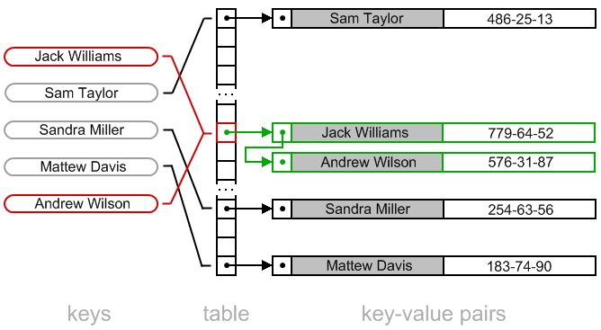
HashMap with Chaining

Slide 84
Chaining
Chained-Hash-Insert( T, x )
insert x at the head of list T[ h( key[x] ) ]
Chained-Hash-Search( T, k )
search for an element with key k
in list T[ h(k) ]
Chained-Hash-Delete( T, x )
delete x from the list T[ h( key[x] ) ]

Slide 85
Hashmap Implementation in Java
public class LinkedHashEntry {
private int key;
private int value;
private LinkedHashEntry next;
LinkedHashEntry(int key, int value) {
this.key = key;
this.value = value;
this.next = null;
}
public int getValue() {
return value;
}
public void setValue(int value) {
this.value = value;
}
public int getKey() {
return key;
}
public LinkedHashEntry getNext() {
return next;
}
public void setNext(LinkedHashEntry next) {
this.next = next;
}
}

Slide 86
Search operation
public class HashMap {
private final static int TABLE_SIZE = 128;
LinkedHashEntry[] table;
HashMap() {
table = new LinkedHashEntry[TABLE_SIZE];
for (int i = 0; i < TABLE_SIZE; i++)
table[i] = null;
}
public int get(int key) {
int hash = (key % TABLE_SIZE);
if (table[hash] == null)
return -1;
else {
LinkedHashEntry entry = table[hash];
while (entry != null && entry.getKey() != key)
entry = entry.getNext();
if (entry == null)
return -1;
else
return entry.getValue();
}
}

Slide 87
Insert operation
public void put(int key, int value) {
int hash = (key % TABLE_SIZE);
if (table[hash] == null)
table[hash] = new LinkedHashEntry(key, value);
else {
LinkedHashEntry entry = table[hash];
while (entry.getNext() != null && entry.getKey() != key)
entry = entry.getNext();
if (entry.getKey() == key)
entry.setValue(value);
else
entry.setNext(new LinkedHashEntry(key, value));
}
}

Slide 88
Delete operation
public void remove(int key) {
int hash = (key % TABLE_SIZE);
if (table[hash] != null) {
LinkedHashEntry prevEntry = null;
LinkedHashEntry entry = table[hash];
while (entry.getNext() != null && entry.getKey() != key) {
prevEntry = entry;
entry = entry.getNext();
}
if (entry.getKey() == key) {
if (prevEntry == null)
table[hash] = entry.getNext();
else
prevEntry.setNext(entry.getNext());
}
}
}

Slide 89
Lock Based HashMap
template <class K, class V>
class WRRMMap {
Mutex mtx_;
Map<K, V> map_;
public:
V Lookup(const K& k) {
Lock lock(mtx_);
return map_[k];
}
void Update(const K& k, const V& v) {
Lock lock(mtx_);
map_[k] = v;
}
};

Slide 90
Lock Free HashMap
template <class K, class V>
class WRRMMap {
Map<K, V>* pMap_;
public: V Lookup (const K& k) {
return (*pMap_) [k];
}
void Update(const K& k, const V& v) {
Map<K, V>* pNew = 0;
do {
Map<K, V>* pOld = pMap_;
delete pNew; pNew = new Map<K, V>(*pOld);
(*pNew) [k] = v; } while (!CAS(&pMap_, pOld, pNew));
}
};

Slide 91
Lock Free HashMap
Reads have no locking at all.
Updates make a copy of the entire map, update the copy, and then try to CAS it with the old map.
While the CAS operation does not succeed, the copy/update/CAS process is tried again in a loop.
Because CAS is limited in how many bytes it can swap, WRRMMap stores the Map as a pointer and not as a direct member of WRRMMap.

Slide 92
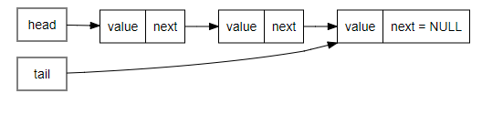
Concurrent Queues
FIFO Data structure

Slide 93

Functionality
Enqueue and Dequeue
Michael and Scott method – having a lock for head and tail

Slide 94

Enqueue and Dequeue

Slide 95

Concurrent Queues

Slide 96
Concurrent Enqueue and Dequeue
While inserting, lock the head
While deleting, lock the tail
Dequeue process does not have to wait when Enqueue is taking place

Slide 97
void Queue_Enqueue(queue_t *q, int value)
{
node_t *new = malloc(sizeof(node_t));
pthread_mutex_lock(&q->tailLock);
q->tail->next = new;
q->tail = new;
pthread_mutex_unlock(&q->tailLock);
}

Slide 98
int Queue_Dequeue(queue_t *q, int *value)
{
pthread_mutex_lock(&q->headLock);
node_t *tmp = q->head;
node_t *newHead = tmp->next;
*value = tmp->value;
q->head = newHead;
pthread_mutex_unlock(&q->headLock);
free(tmp);
}

Slide 99
Lock free Queue
Takes local copy of the shared resource -> performs task
CAS compares with shared resource to check for changes in shared resource(from another process, possibly) after local copy was taken
If no change → swap common data structure with the changed local copy
If it has been changed by another process → Take another local copy of the changed data structure and perform

Slide 100
CAS – Compare and Swap
int CAS (int * addr , int * expected , int value )
{
if (* addr == * expected )
{
* addr = value ; return 1; // swap success
}
else
{
* expected = * addr ; return 0; // swap failed
}
}

Slide 101
Lock Free queue
do
{
t = tail;
tail->next = node;
}while(!CAS(&tail , t , node) )

Slide 102

Deadlock

Slide 103


Slide 104
Pathfinder
Shared Memory access based on priority
Mars Pathfinder – NASA’s solar exploration expedition
Pathfinder was launched to Mars on December 1996, to get geological information about the planet.

Slide 105
Design
3 periodic tasks
Task 1 – Information Bus Thread: Bus Manager high frequency, high priority(H)
Task 2 – Communication Thread medium frequency / priority, high execution time(M)
Task 3 – Weather Thread: Geological Data Gatherer low frequency, low priority(L)
a watchdog timer was used to reset the system in the event that the computer / software locks up

Slide 106


Slide 107
Solution
Priority inversion(inheritance)
If mutex is requested by high priority task and it is currently with low priority task, the low priority task inherits the property of the high priority task

Slide 108
In general deadlock conditions are very application specific.
Need to cover specific scenarios while designing.
For eg. In dining philosopher problem, test if chopsticks on both sides are free.

Slide 109

Thank you!

